Slide 1
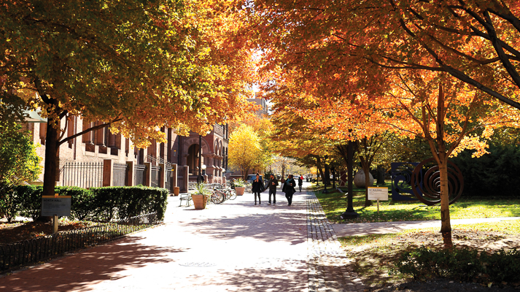
Project SEARCH
At Pratt Institute

Slide 2
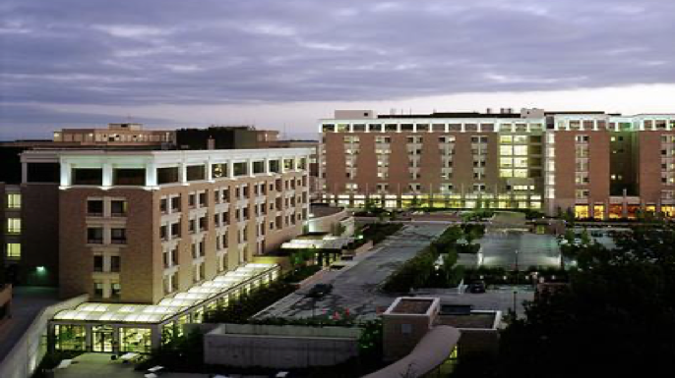
Project SEARCH: History
Founded in 1996
Cincinnati's Children Hospital
Erin Riehle – Director of the ER Department
Susie Rutkowski-Director for Special Education
Hosts over 600 programs in 45 states and 9 countries.

Slide 3
AHRC NYC : Where We Are Now
2014
Two Project SEARCH programs operated by FEGS
Bronx - Montefiore Medical Center
Brooklyn - Wyckoff Heights Medical Center
2017
New Project SEARCH sites
Staten Island - Staten Island University Hospital
Queens - Queens Presbyterian Hospital
Manhattan - RXR Real Estate Developer
2021
New Brooklyn Project SEARCH site
Pratt Institute
Brooklyn - moved to The Brooklyn Hospital Center

Slide 4
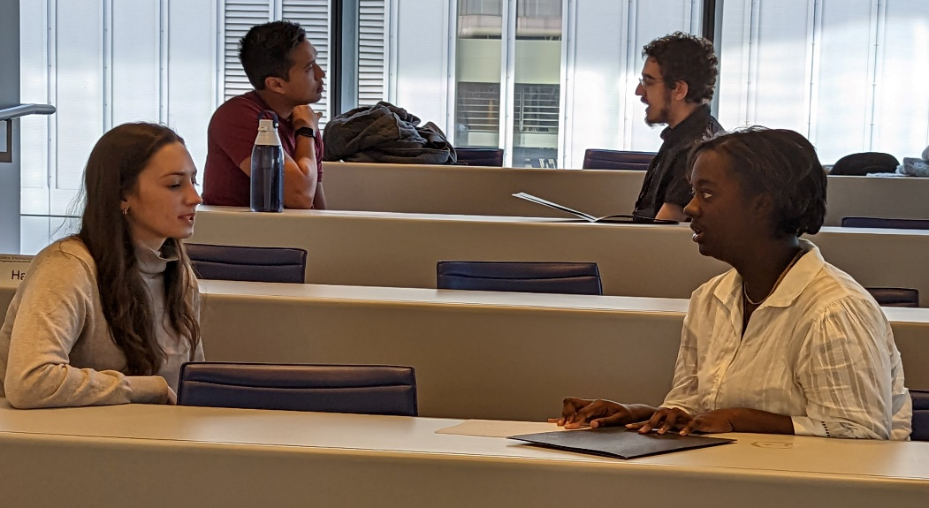
Desired Outcomes
100% Competitive Employment in the Community
Job placement within one year of graduation
Part-time or full-time employment with a minimum of 16 hours per week
Change business culture and stereotypes towards people with disabilities
Create a more diverse workforce mirroring the public

Slide 5
Partnerships
Host Business
Student
NYC Department of Education
ACCES-VR
z
AHRC

Slide 6
Program Design
One year work immersive program
12 participants – variety of disabilities
Ages 20-21 years old or in their last year of high school
Support from lead teacher employment skills instructor, paraprofessional, and department mentor(s)
3 internship rotations at 10-12 week intervals
Program teaches competitive, marketable, transferable skills for employment, where interns learn a variety of new skills in each department
Notes:
So, what exactly is Project SEARCH?
Project SEARCH is a 1-year transition-to-work program.
We refer to Project SEARCH as a “one and done” experience in the sense that it is our expectation that participants who come to Project SEARCH will work hard during the program year and exit into competitive employment. This means that participants will not be returning to ArcWorks. We are looking for participants who are serious about pursuing employment and who intend to use this year to work hard and prepare for competitive employment.
Participants have the opportunity to participate in up to four internships during the program year.

Slide 7
Non-College Bound Standardized Students are Welcomed
Students must meet the criteria for graduation prior to entering the program.
The diploma issuing Community School must agree to hold their diploma for one academic year.
Student goes on shared instruction between P721K and the Community School.
"Student is remaining with the Dept. Of Education for an additional year to meet their Measurable Post-Secondary Goals"

Slide 8
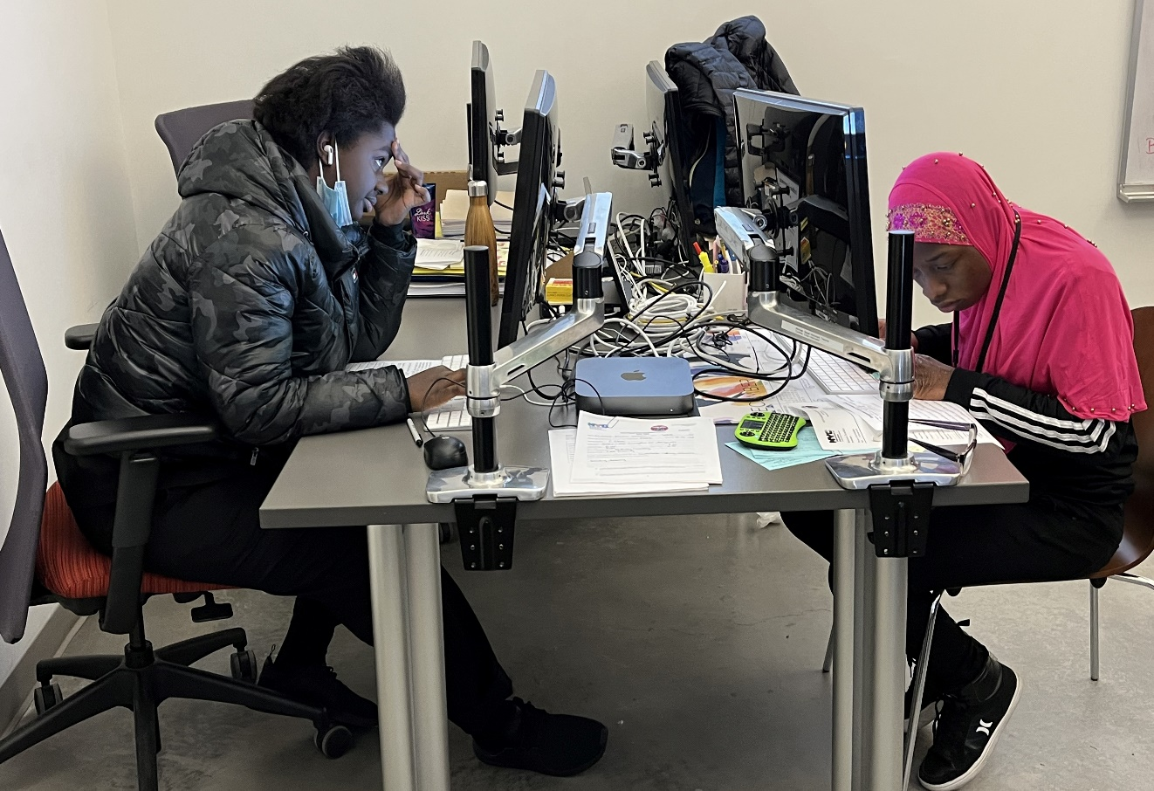
Project SEARCH Curriculum
Team building
Workplace safety
Technology
Social skills/communication skills
Interview skills
Resume writing
Financial literacy
Health and wellness

Slide 9
Typical Program Day
8:30am-Vocational, social, and independent living skills
9:00am-Internship
12:00pm-Lunch
1:00pm-Internship
2:00pm-Continuation of employability skills
2:45pm-Depart

Slide 10
Program Schedule
SEPT.
JUNE
Begin PS Program
1st rotation
2nd rotation
3rd rotation
Graduate & seek employment
Transition Week
Transition Week
1-week Orientation
Notes:
This is a graphic of how the school year works.
We start in late August with an orientation to the program.
The first few weeks of the school year are spent in the classroom, where the goal is to get acclimated to the business, and to explore internship preferences.
At Wegmans, this is a time to compete all of the necessary community-based training that all Wegmans employees are required to complete before starting out on the floor.
At URMC, students much compete all necessary in-service trainings, and understand things like HIPPA and universal precautions – all necessary aspects of working in a hospital setting.
Internships run from 8-12 weeks in length depending on the time of year.
Between each internship, students participate in a workshop week, where they are back in the classroom enhancing their skills, updating resumes, and preparing for the next internship rotation.

Slide 11
Program Meetings
Monthly steering committee meetings
Parent meetings
Employment planning meetings
Business advisory meetings
Recruitment and open house meetings

Slide 12
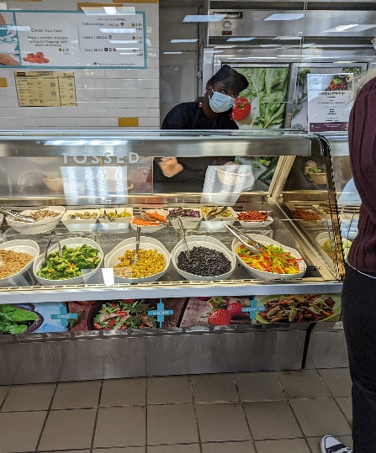
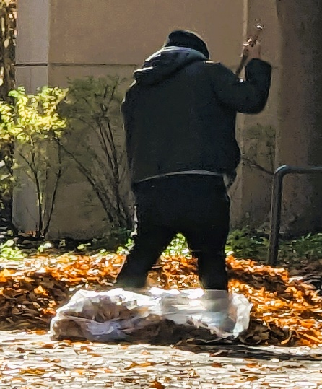
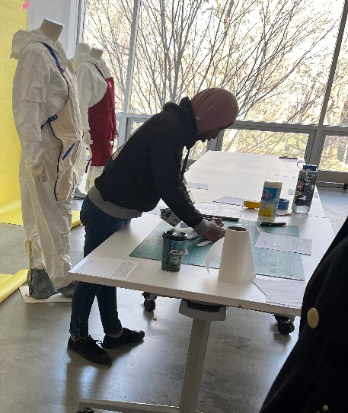
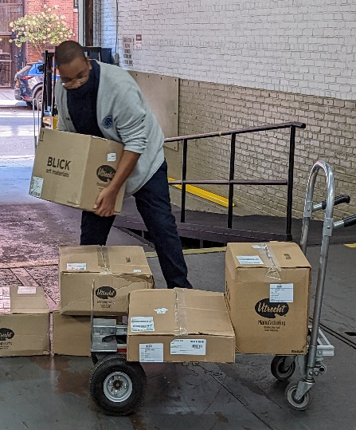
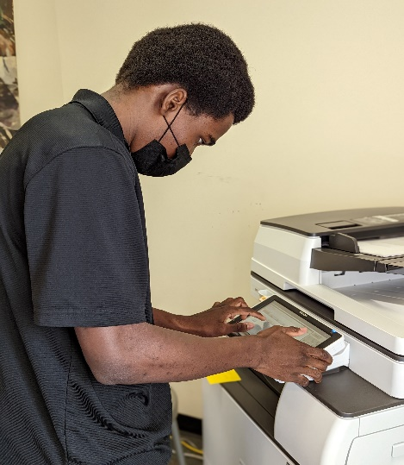
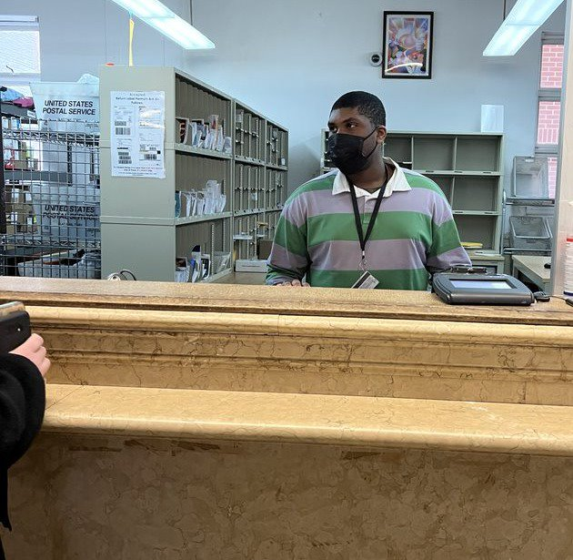
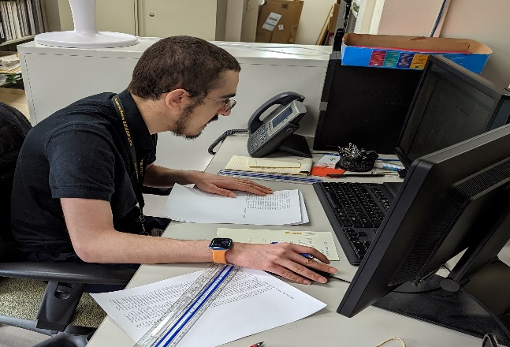
Internships at Pratt
Cafeteria
Groundskeeping
School of Design
Receiving
Registrars
Facilities
Admissions
IT-Instructional Technologies
Mailroom
Comptroller

Slide 13
Employment Outcomes
2020 Graduates
6 out of 7 employed
2021 Graduates (*covid year)
4 out of 8 employed
2022 Graduates
6 out of 9 employed

